Slide 1
Rethinking Software Systems
A Friendly Introduction to
Behavioral Programming
Michael Bar-Sinai
@michbarsinai
Notes:
Thanks for coming

Slide 2
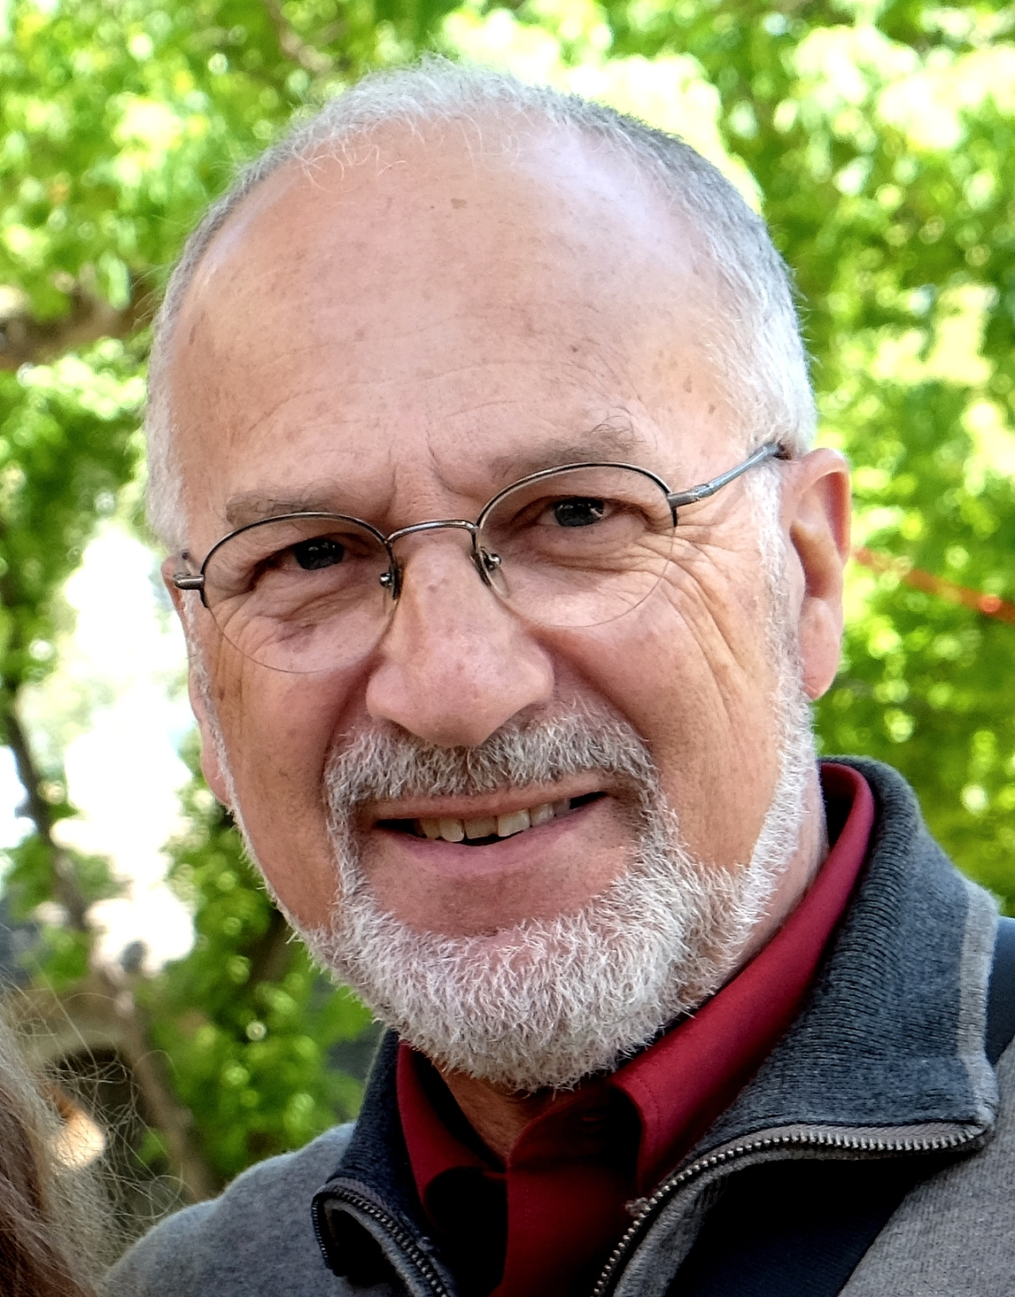
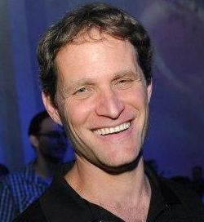
Behavioral Programming (BP)
Programming Paradigm Introduced in 2010 by David Harel, Assaf Marron and Gera Weiss
Rooted in Scenario-Based Programming (Damm, Harel, Marelly)
Large body of scientific work around this: algorithms, visualizations, event selection, interoperation.
Implementations in Java, C++, Erlang, StateCharts
Notes:
What's a paradigm?
A way of thinking about problems/complex systems. Meant for humans, can be translated to machine code
OOP: 1970s (roots in the 60s)
FP: 1930 (lambda calculus), LISP late 1950s
Expect weird, but in a good way.
Same weird/wonder as when first seen FP/OOP. ... Large impressive body of scientific work on this, but little attention from the industry.

Slide 3
DEVOXX 2018
first major non-academic conference
hosting a BP talk
First
Behavioral Programming with React Luca Matteis, ReactjsDay, Italy, October 2018
Notes:
... new, weird.
First talk: Luca Matteis, ReactjsDay Italy, October 2018
Starting to make inroads into the industry. Based on a lot of worthy scientific work.
Came for Master's, stayed for PhD.
Event weirder, because...

Slide 4
Programming
Modeling
Telling a computer
What to do
Telling a computer
What could be done
can't be done
BP
Notes:
in modeling, can also forbid things
So we can tell the computer also when NOT TO DO
Goes back to scenario based "Negative scenarios"
Partial Specification

Slide 5
Hello, world!
bp.registerBThread("bt-1", function(){
bp.sync({request:bp.Event("hello")});
});
bp.registerBThread("bt-2", function(){
bp.sync({request:bp.Event("world")});
});
Using BPjs, https://github.com/bThink-BGU/BPjs
Notes:
using BPjs, our open-source library and tool suite for running and analyzing BP code
Syntax is JS, semantics are BP (mostly threading and execution)
JS engine is Mozilla Rhino
To borrow a term Venkat's Keynote yesterday, b-threads are internal conversations a system has with itself.

Slide 6
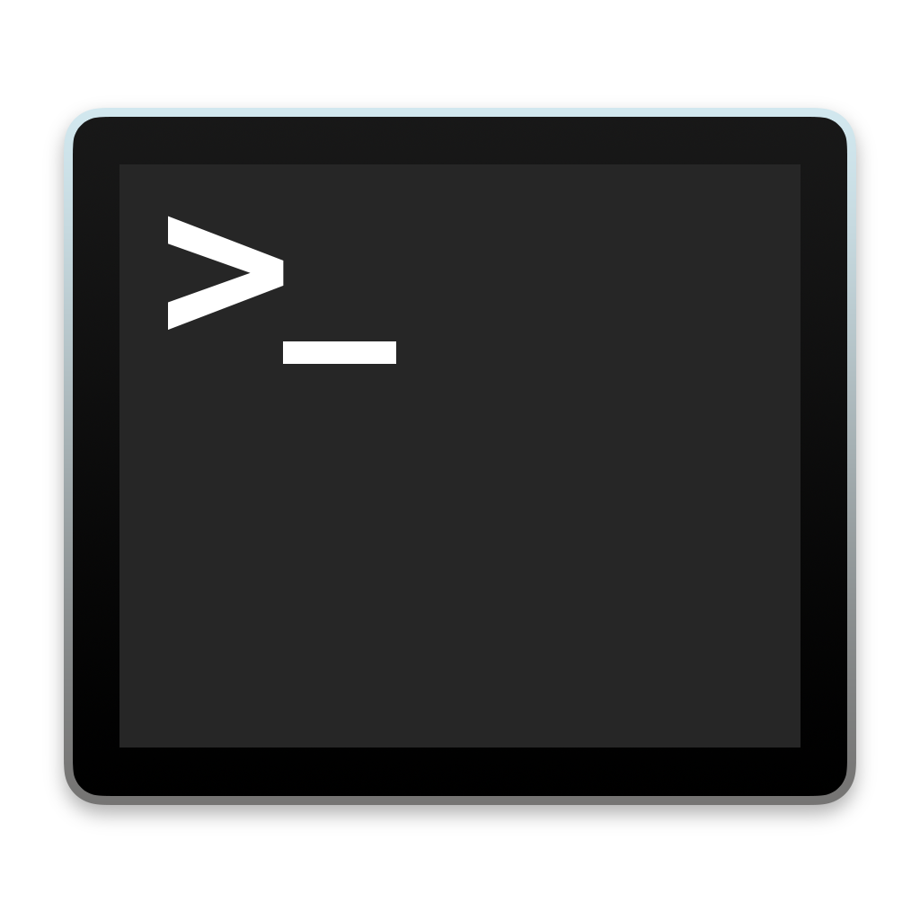
Demo
Notes:
run until we get conflicting behaviors.

Slide 7
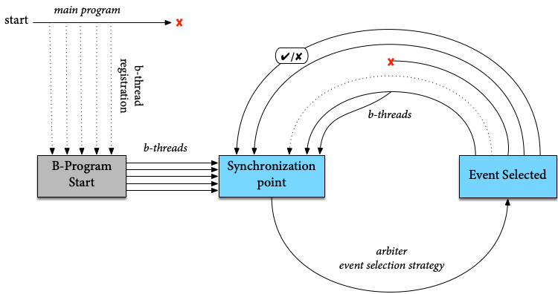
B-Program Life Cycle
Request:
Wait For:
Block:
Notes:
Terms: b-threads, RWB, Sync point
Quick mention event selection strategies

Slide 8
Hello ordered world
bp.registerBThread("enforce-order", function(){
bp.sync({
waitFor:bp.Event("hello"),
block:bp.Event("world")
});
});
bp.registerBThread("bt-1", function(){
bp.sync({request:bp.Event("hello")});
});
bp.registerBThread("bt-2", function(){
bp.sync({request:bp.Event("world")});
});
Notes:
read imperative, invite to read declarative.
Telling a computer what not to do. In it's own, does nothing.

Slide 9
Demo
Notes:
Just show that this works.
May add hello Devoxx2018

Slide 10
Hello World Takeaways
Additivity / Composability
Modularity
Asynchronous-first approach
Notes:
Additivity: existing code was not changed when forcing order
Modularity: No effects in the modules, control the way modules are interweaved to a system

Slide 11
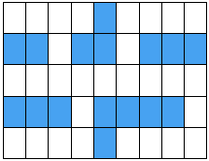
House Model
Simulate a robot moving inside a house
Notes:
How to model this?
OOP style: model a walker that maintains state. Cell class hierarchy.
BP: Cell variability using additional behaviors. Negative model.

Slide 12
House Model
Simulate a robot moving inside a house
var house =
[" # t ",
"## ## ###",
" ",
"### #### ",
" s# "];
Notes:
How to model this?
OOP style: model a walker that maintains state. Cell class hierarchy.
BP: Cell variability using additional behaviors. Negative model.

Slide 13
Parsing into B-Threads: Idea
Parsing:
Iterate over characters in the house description string array.
Generate b-threads for each cell based on the character.
[" # t ",
"## ## ###",
" ",
"### #### ",
" s# "];

Slide 14
Parsing into B-Threads - Code
function parseMaze(mazeLines) {
for ( var row=0; row<mazeLines.length; row++ ) {
for ( var col=0; col<mazeLines[row].length; col++ ) {
var currentPixel = mazeLines[row].substring(col,col+1);
if ( currentPixel===" " ||
currentPixel==="t" ||
currentPixel==="s" ) {
addSpaceCell(col, row);
if ( currentPixel==="t" ) {
addTargetCell(col, row);
} else if ( currentPixel==="s" ) {
addStartCell(col, row);
}
}
}
}
}
"Different types of cells have different behaviors"
Notes:
Compositing over inheritance (as many OOP design patterns do, Rust)

Slide 15
Behaviors for a Space Cell
function addSpaceCell( col, row ) {
bp.registerBThread("cell(c:"+col+" r:"+row+")",
function() {
while ( true ) {
bp.sync({waitFor:adjacentCellEntries(col, row)});
bp.sync({
request: enterEvent(col, row),
waitFor: anyEntrance
});
}
}
);
}
[" # t ",
"## ## ###",
" ",
"### #### ",
" s# "];

Slide 16
Behaviors for a Target Cell
function addSpaceCell( col, row ) {...}
+
function addTargetCell(col, row) {
bp.registerBThread("Target(c:"+col+" r:"+row+")", function(){
bp.sync({
waitFor: enterEvent(col, row)
});
bp.sync({
request: TARGET_FOUND,
block: bp.allExcept( TARGET_FOUND )
});
});
}
[" # t ",
"## ## ###",
" ",
"### #### ",
" s# "];

Slide 17
Behaviors for a Start Cell
function addSpaceCell( col, row ) {...}
+
function addStartCell(col, row) {
bp.registerBThread("starter(c:"+col+" r:"+row+")", function() {
bp.sync({
request:enterEvent(col,row)
});
});
}
[" # t ",
"## ## ###",
" ",
"### #### ",
" s# "];

Slide 18
Runtime Stack
BP Code
bp
BPjs BProgramRunner
Listeners
Event Queue
Host Java Application
JVM

Slide 19
Demo
Let's Go!
Notes:
No walls, no walker, essence. "Walking robot, with just the walking, and none of the robot".
Also, no state changes except for program counters.
Delivered on the "weird" promise.
Why do we need this weird, insane paradigm?

Slide 20
bp.registerBThread("cleaner", function(){
bp.sync({waitFor:PrintPage});
bp.sync({waitFor:PrintPage});
bp.sync({waitFor:PrintPage});
bp.sync({
request: CleanInkJets,
block: PrintPage
});
});
"After the first three pages, clean the ink jets"

Slide 21
bp.registerBThread("cleaner", function(){
while ( true ) {
bp.sync({waitFor:PrintPage});
bp.sync({waitFor:PrintPage});
bp.sync({waitFor:PrintPage});
bp.sync({
request: CleanInkJets,
block: PrintPage
});
}
});
"Every three pages, clean the ink jets"

Slide 22
bp.registerBThread("limitConsumption", function(){
var count = 0;
while (true) {
var evt = bp.sync({waitFor:[AnyUsageStart, AnyUsageEnd]});
if ( AnyUsageStart.contains(evt) ) {
count++;
} else if ( AnyUsageEnd.contains(evt) ) {
count--;
}
if ( count === LIMIT ) {
bp.log.info("limiting...")
bp.registerBThread("tempBlock", function(){
bp.sync({
waitFor:AnyUsageEnd,
block:AnyUsageStart
});
});
}
}
});
"Do not use more than LIMIT resources at a time"

Slide 23
Requirement Alignment
function blockOrdersWhenOutOf( p ) {
return function(){
while(true) {
bp.sync({waitFor: OutOfStock(p)});
bp.sync({
waitFor: RefillDone(p),
block: Order(p)
});
};
};
}
bp.registerBThread(blockOrdersWhenOutOf(p1));
bp.registerBThread(blockOrdersWhenOutOf(p2));
"when we run out of a products p1 and p2, do not allow new orders until the stock is renewed"
Notes:
Instantiate requirements - direct representation of what our system is required to do
Requirements as first-class citizens. Cf. OOP and FP where the first class citizens are the programming artifacts.

Slide 24
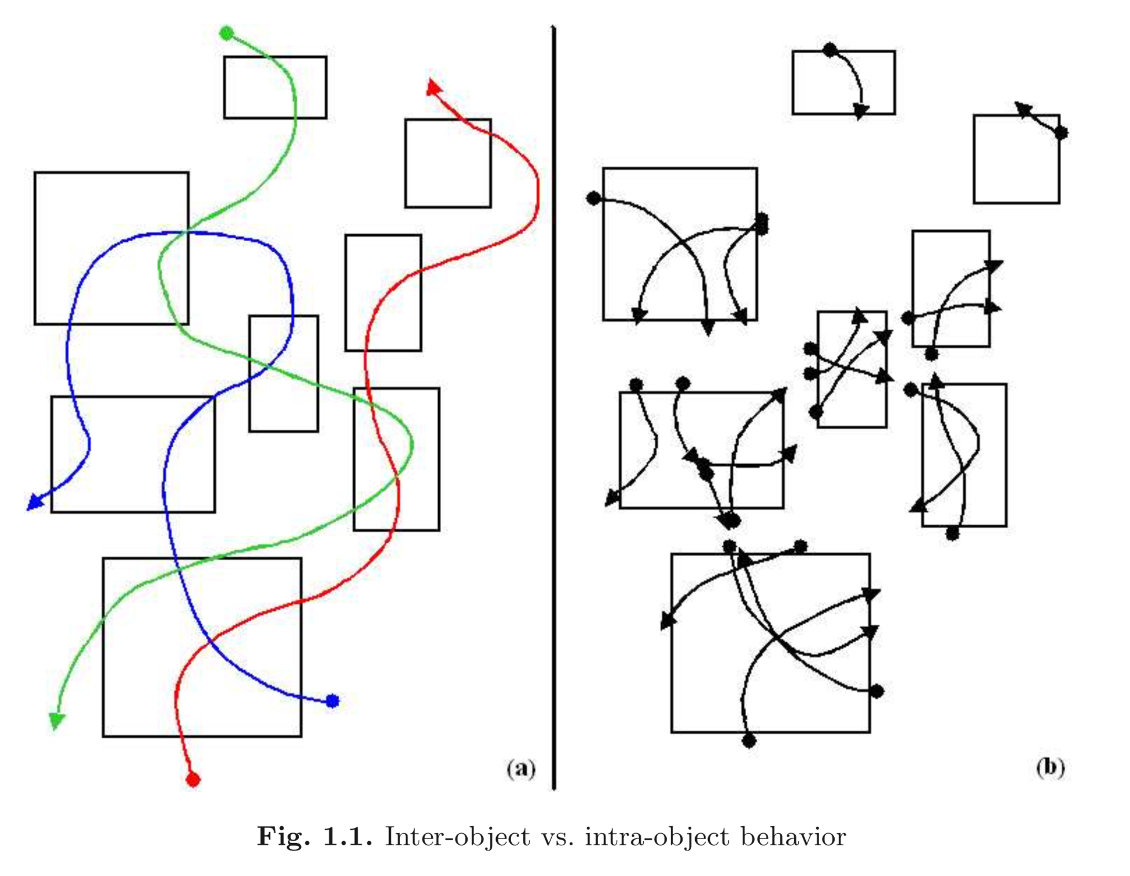
Image Credit: David Harel, Rami Marelly. Come, Let's Play - Scenario Based Programming Using LSCs and the Play-Engine
Notes:
Book: 2003
... Another cool thing we can do:

Slide 25
Cell(1,0)
Cell(3,0)
Cell(2,0)
Cell(0,0)
Start(0,0)
Target(3,0)

Slide 26
Cell(0,0)
Cell(1,0)
Cell(2,0)
Cell(3,0)
Start(0,0)
Target(3,0)
TARGET_FOUND
Notes:
Automaton, but with possibly infinite states, and probably a huge number of states. But this is still useful.
THIS IS NOT TESTING!
Traversed using continuations. No model transformation, static analysis.

Slide 27
Verification Detecting "Bad States"
bp.registerBThread("robot-falling", function(){
bp.sync({waitFor:TARGET_FOUND});
bp.ASSERT(false, "Robot fell into trap");
});
Notes:
"Requirement b-thread"

Slide 28
Keeping the Robot Safe
Add the "robot-falling" b-thread to the maze b-program
Traverse state graph (currently using DFS, A* demonstrated)
When hitting failed assertion, output trace
Use assumptions where possible (right)
bp.registerBThread("onlyOnce",
function(){
var visited = [];
while (true) {
var evt = bp.sync({
waitFor: anyEntrance,
block: visited
});
visited.push(evt);
}
});

Slide 29
Demo
Ah Ah Ah Ah
Staying alive
Staying alive
Notes:
"Forget indistinguishable from magic, this stuff works during live demos"

Slide 30
Verification in BPjs
BProgram bprog = new StringBProgram(mazesSource);
bprog.prependSource(mazeJs);
bprog.appendSource(assumptionsSrc);
bprog.appendSource(requirementSrc);
DfsBProgramVerifier vfr = new DfsBProgramVerifier();
vfr.setDetectDeadlocks(false);
vfr.setProgressListener(...);
VerificationResult res = vfr.verify(bprog);

Slide 31
SE ❤️ BP
?
B-Program Verifier
"Mainstream" System
B-Program
(model)
Listener API
Environment Simulation
Assumptions
Requirement b-threads
B-Program Runner
External Event Queue
Event Selection Strategy
Notes:
ESS - can be AI, EA, ML, my favorite: java.util.Random
Model Driven Engineering (MDE)

Slide 32
So What?

Slide 33
There are two ways of constructing a software design: One way is to make it so simple that there are obviously no deficiencies, and the other way is to make it so complicated that there are no obvious deficiencies.
C.A.R Hoare, in The Emperor's Old Clothes,
Turing Award lecture, 1980
Photograph by Rama, Wikimedia Commons, Cc-by-sa-2.0-fr
Notes:
Charles Antony Hoare

Slide 34
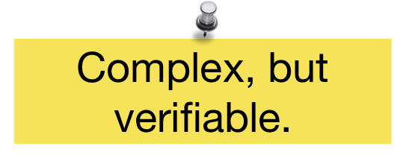
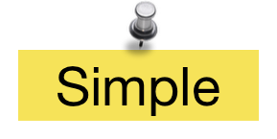
Why not Both?
B-Program
(model)
Event Selection Strategy
*
Or, at least, partially verified, testable, and possibly runtime verified
B-Program Runner
"Mainstream" System
Input
Output
Long running processes
Notes:
Verification is and will be a time/effort tradeoff.
A form of "Model Driven Engineering", well established domain
... So we can now do highly reliable software in JavaScript, what should we do with it?

Slide 37
Joel Greenyer, Michael Bar-Sinai, Gera Weiss, Aviran Sadon and Assaf Marron.
Modeling and programming a leader-follower challenge problem with scenario-based tools.
MDETools Workshop @ MODELS2018, Copenhagen

Slide 38
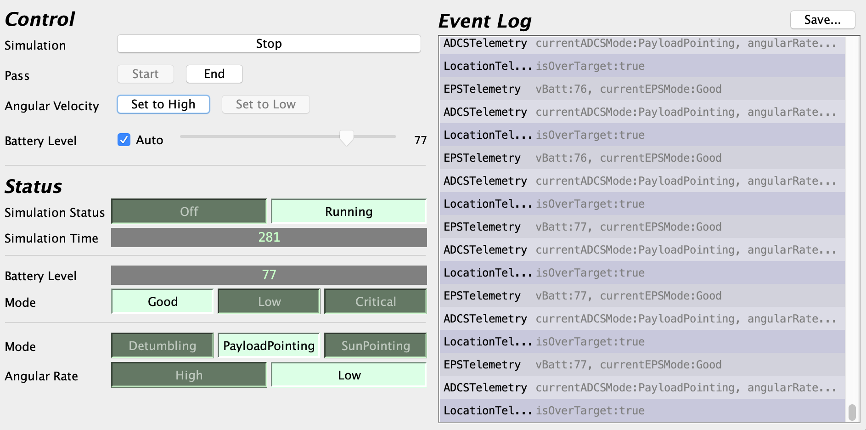
Space Applications

Slide 39
BPjs a BP Tool Suite for JS
Open Source (MIT)
Embeddable / Commandline
Continuous UT+CC, Documentation
GitHub Repo, Maven Central, Jars
Sample code
JS using Mozilla Rhino
Other tools out there too!
<dependency>
<groupId>com.github.bthink-bgu</groupId>
<artifactId>BPjs</artifactId>
<version>0.9.3</version>
</dependency>
*mostly
Notes:
modern industry standards

Slide 40
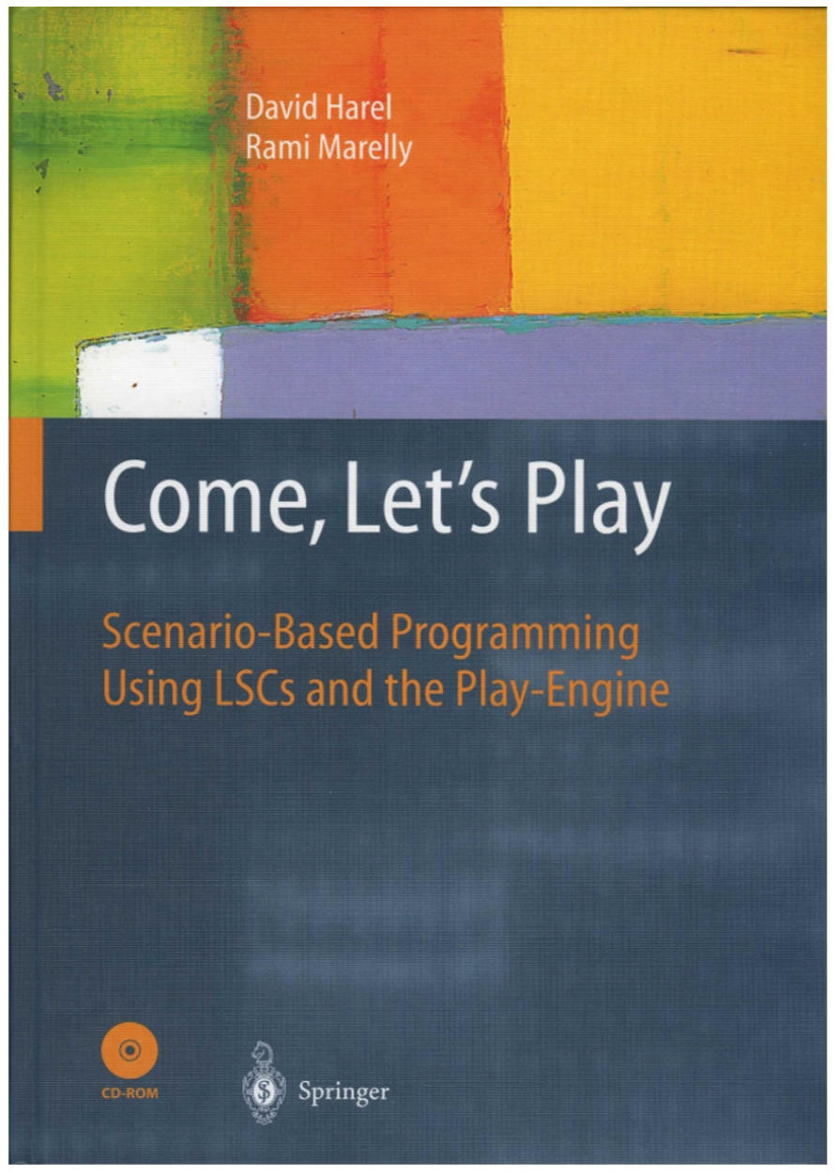
People and Works
Scenario Based Programming
Live Sequence Charts: Werner Damm, David Harel (1999, 2001)
David Harel, Rami Marelly, Come, Let's Play: Scenario-Based Programming Using LSCs and the Play-Engine (2003)
Behavioral Programming
David Harel, Assaf Marron, Gera Weiss (2010, 2012)
BPjs developed at BGU Software Engineering Group, Gera Weiss (2017)
Michael Bar-Sinai, Aviran Sadon, Reut Shmuel, Moshe Weinstock
Collaborating with David Harel's Group, Assaf Marron
SE/CS Students
Other BP Groups:
Weizmann Institute of Science (David Harel),
Leibniz Universität Hannover (Joel Greenyer)
JS/React: https://github.com/lmatteis/behavioral (Luca Matteis)
Notes:
BPjs based on other internal projects
Seeking new collaborators and early adopters.
Starting to form a community
IF you feel like an early adopter or want to squish your brain in a new direction...

Slide 41
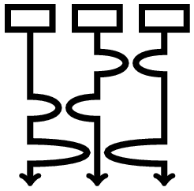
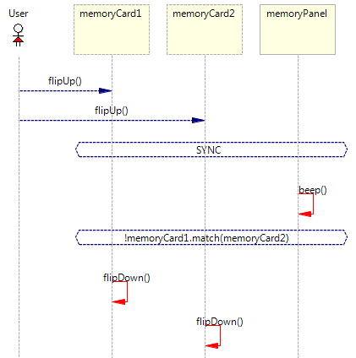
Resources
b-prog.org: Main BP site, including other BP frameworks (C++, Java, Erlang, Blockly)
Academic Papers (algorithms, event selections, visualizations, ...) Behavioral Programming, Live Sequence Charts (LSCs)
github.com/bthink-BGU: BPjs, projects presented in this talk
bpjs.readthedocs.io: BPjs tutorial and reference
groups.google.com/forum/#!forum/bpjs: Google group
scenariotools.org Live Sequence Charts take on this subject, Joel Greenyer

Slide 42
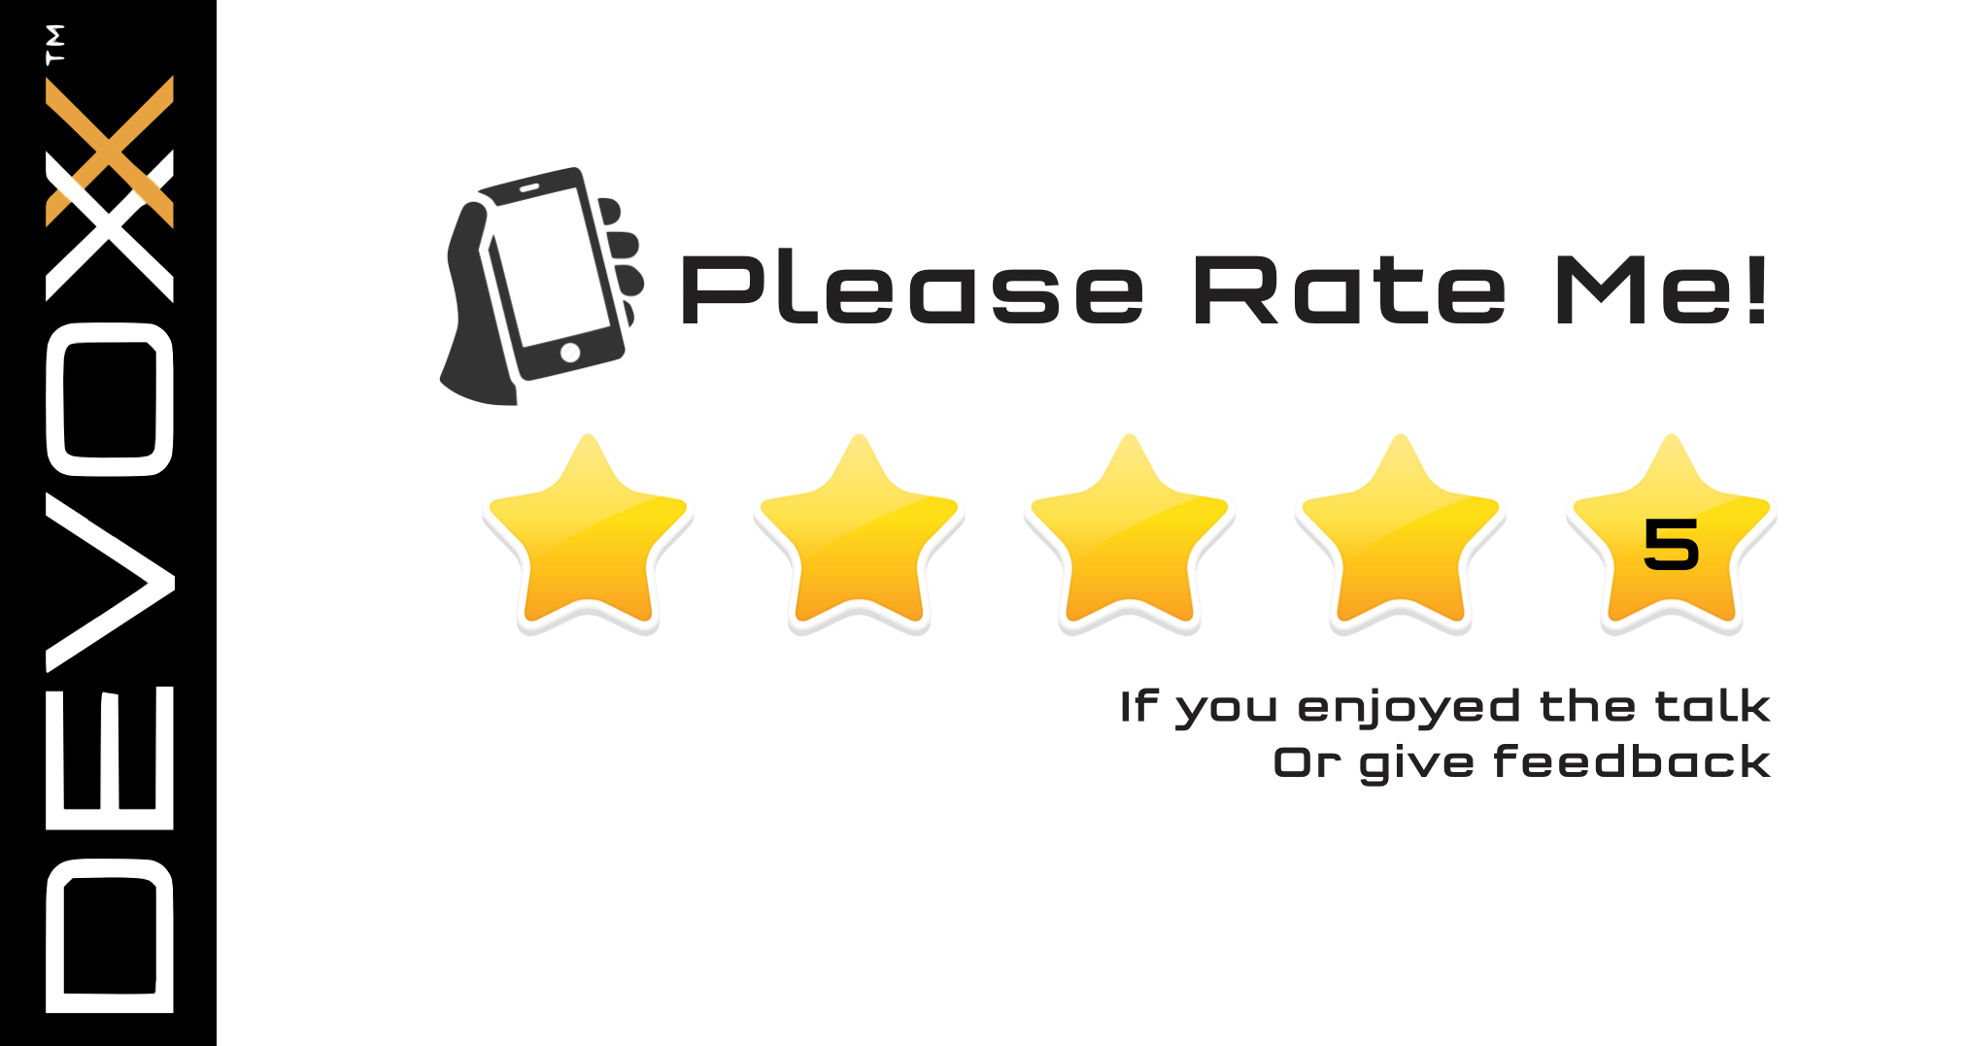
// Thanks.
bp.sync({
waitFor:questions
});
@michbarsinai
Partial funding for this presentation generously granted by the Frenkel Foundation, BGU
http://b-prog.org
http://github.com/bthink-BGU

